Slide 1
1
Network Fundamentals

Slide 2
SLIDE NO: 2
TEAM MEMBERS
NANDINI N 094005
ARVETHI NAVEEN 093939
DIVYASHREE V 093950
MAHANTHESH KUMBAR 093957
SAI KRISHNA 094036
MONISHA S M 093952
SLIDE NO: 2

Slide 3
TRANSPORT LAYER
SLIDE NO: 3

Slide 4
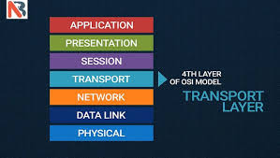
TRANSPORT LAYER
The transport layer is the layer in the open system interconnection (OSI) model responsible for end-to-end communication over a network.
It provides logical communication between application processes running on different hosts within a layered architecture of protocols and other network components.
SLIDE NO: 4

Slide 5
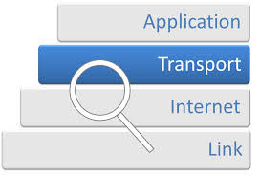
Major duties of Transport layer are:
Creating an end-to-end connection between hosts in different network
Error recovery
Flow control
Ensuring complete data transfer in TCP
Congestion avoidance
SLIDE NO: 5

Slide 6
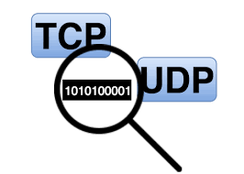
PROTOCOL
Protocol is a set of rules describes how data is transmitted over a network.
Protocols are needed for communication between any two devices.
Major Transport Layer protocols
TCP( Transmission Control Protocol)
UDP( User Datagram Protocol)
SLIDE NO: 6

Slide 7

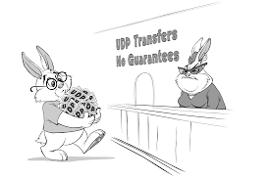
TRANSMISSION CONTROL PROTOCOL(TCP)
Connection oriented
Reliable delivery of data
Ordering of delivery
USER DATAGRAM PROTOCOL(UDP)
Connectionless service
Delivery is not guarantee
SLIDE NO: 7

Slide 8
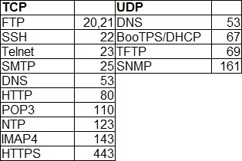
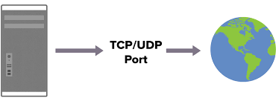
PROTOCOL PORT NUMBER
A protocol port number is a way to identify a specific process to which an Internet or other network message is to be forwarded when it arrives at a server
SLIDE NO: 7

Slide 9
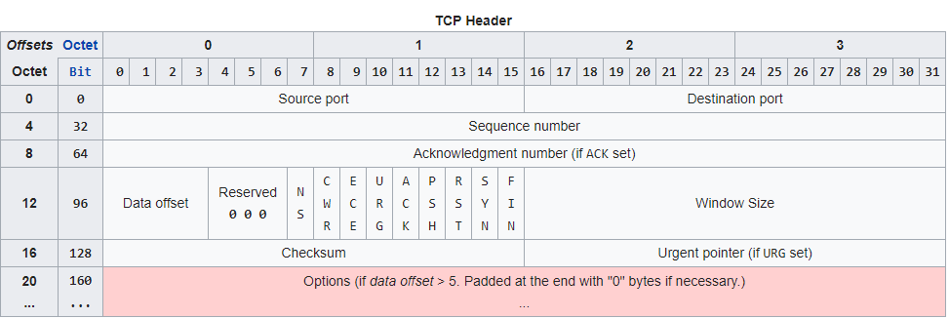
TCP HEADER
Source TCP port number (2 bytes)
Destination TCP port number (2 bytes)
Acknowledgment number (4 bytes)
Sequence number (4 bytes)
TCP data offset (4 bits)
Reserved data (3 bits)
Control flags (up to 9 bits)
Window size (2 bytes)
TCP checksum (2 bytes)
Urgent pointer (2 bytes)
TCP optional data (0-40 bytes)
SLIDE NO: 8

Slide 10
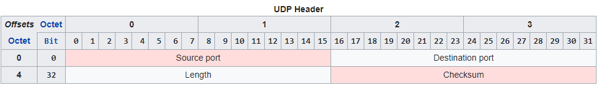
UDP HEADER
Source port number (2 bytes)
Destination port number (2 bytes)
Length of data (2 bytes)
UDP checksum (2 bytes)
SLIDE NO: 9

Slide 11
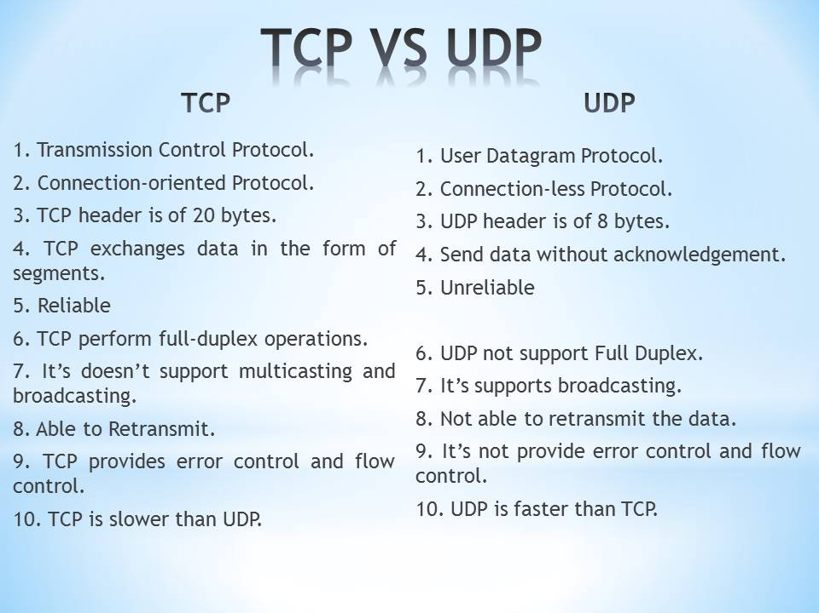
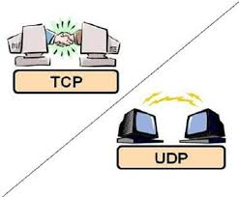
DIFFERENCE BETWEEN TCP AND UDP
SLIDE NO: 10

Slide 12
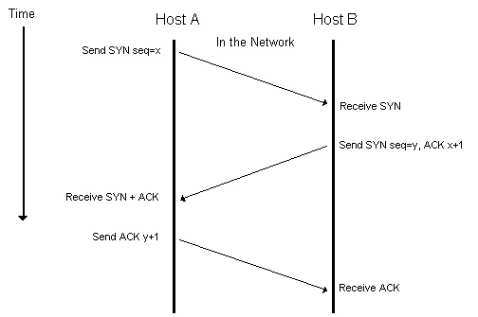
TCP Connection establishment & Termination
SLIDE NO: 11

Slide 13
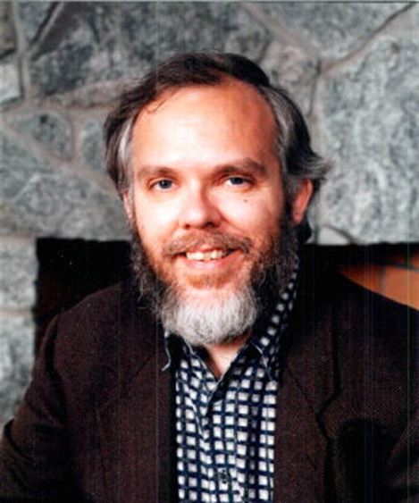
UDP(User Datagram Protocol)
User Datagram Protocol (UDP) is one of the core members of the Internet protocol suite.
The protocol was designed by David P. Reed in 1980.
SLIDE NO: 12

Slide 14
Characteristics of UDP
UDP uses a simple connectionless communication model.
In UDP data referred to as datagrams.
There is no guarantee of delivery or duplicate protection.
UDP is suitable for purposes where error checking and correction are either not necessary.
It is stateless, suitable for very large numbers of clients.
Unreliable Datagram Protocol
SLIDE NO: 13

Slide 15
Network layer
SLIDE NO: 14

Slide 16
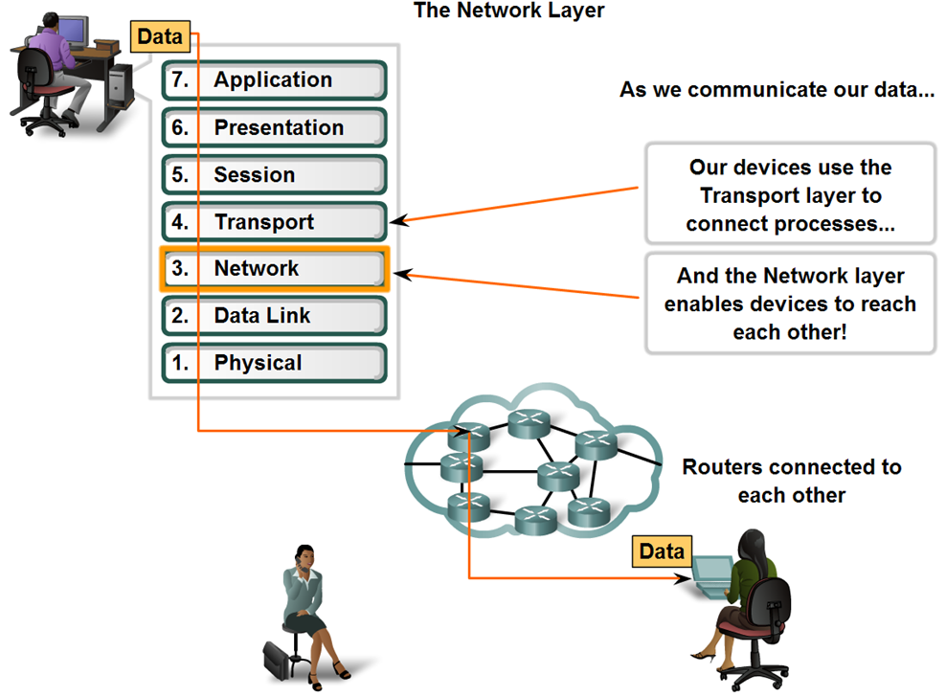
What is Network Layer?
Network Layer provides services to exchange the individual pieces of data over the network between identified end devices.
It uses 4 processes:
Addressing
Encapsulation
Routing
Decapsulation
Functions of the network layer
The Three main Functions of network layer are :
1.Connectionless communication
2.Host addressing
3.Message forwarding
SLIDE NO: 15

Slide 17
Internet Protocols
IPsec
IPsec was originally planned as part of the next-generation IP (IPv6), but security quickly became very important, and IPsec was designed as the Internet security protocol for both IPv4 and IPv6
IPsec is a integral part of IPv6.
Used move to IPv6 packet headers.
Protocols implemented at the Network layer that carry user data include:
Internet Protocol version 4 (IPv4)
Internet Protocol version 6 (IPv6)
Novell Internetwork Packet Exchange (IPX)
AppleTalk
Connectionless Network Service (CLNS/DECNet)
SLIDE NO: 16

Slide 18
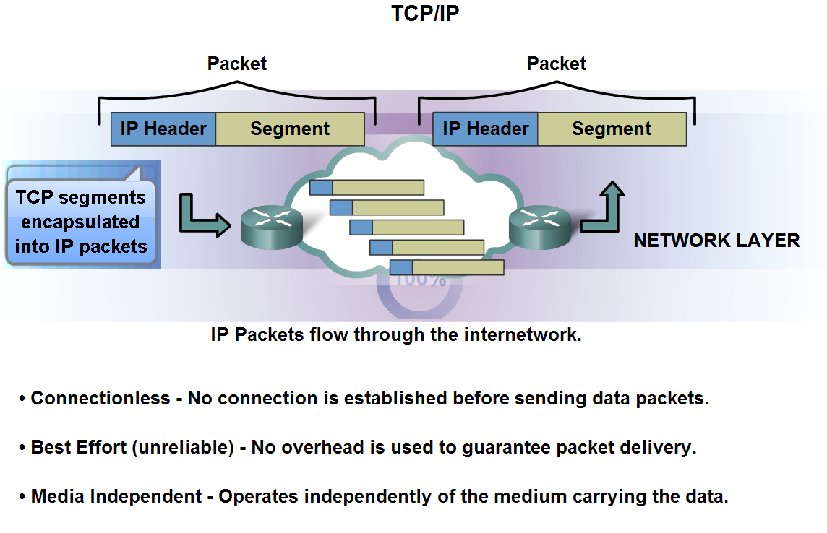
Internet Protocol (IP)
The basic characteristics and the role of the IPv4 protocol:Connectionless, best effort, Media independent
SLIDE NO: 17

Slide 19
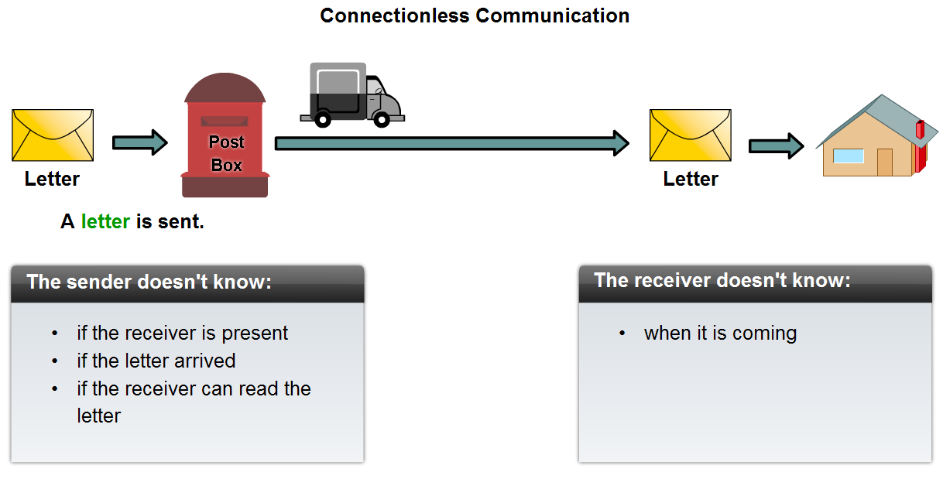
Internet Protocol (IP)
Connectionless Service
SLIDE NO: 18

Slide 20
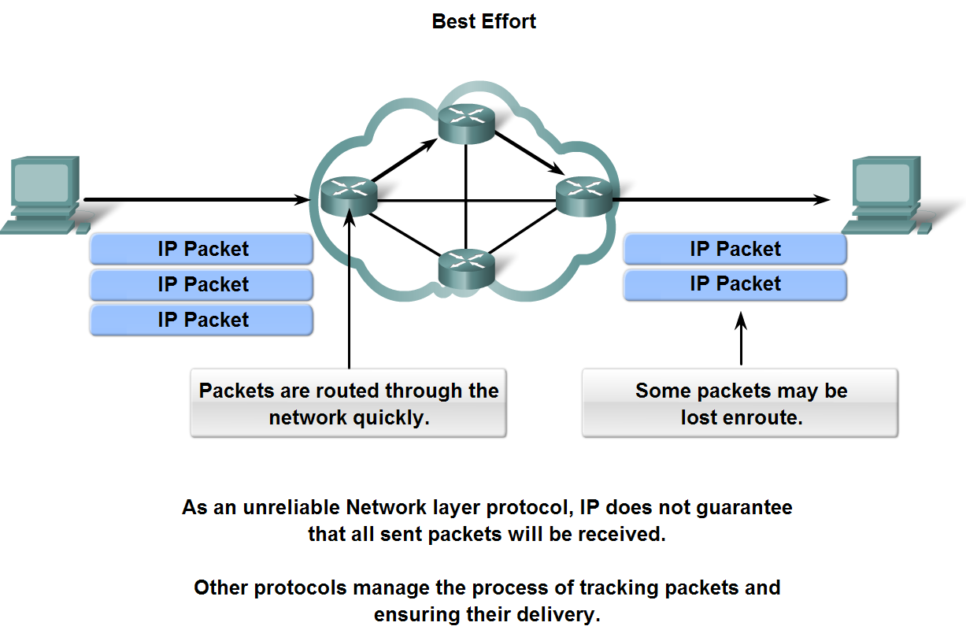
Internet Protocol (IP)
Best Effort Service (unreliable protocol)
SLIDE NO: 19

Slide 21
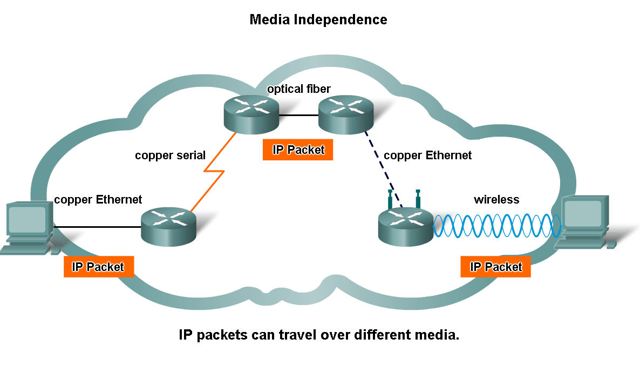
Internet Protocol (IP)
Media independent
SLIDE NO: 20

Slide 22
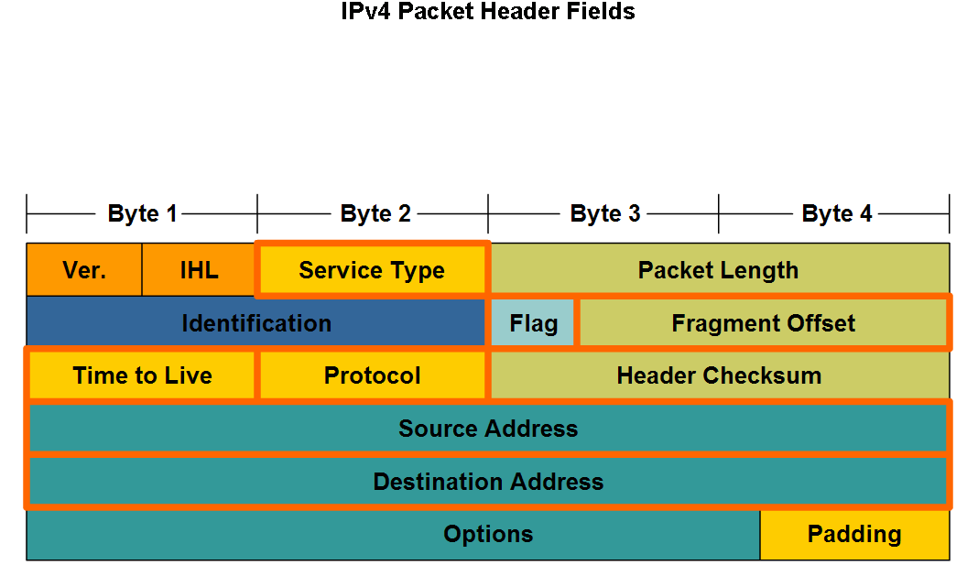
Internet Protocol (IP)
The major header fields in the IPv4 protocol: IP Source Address, IP destination Address, Time To Live (TTL), Type of Service, Protocol, Fragment Offset
SLIDE NO: 21

Slide 23
IPV4 notations
There are two prevalent notations to show an IPV4 address:
Binary notation:
Address is displayed as 32 bits.
Each octet is often referred to as byte.
IPV4 address referred to as 32-bit address or 4-byte address.
Example: 01110101 10010101 00011101 00000010
Dotted-decimal notations:
Written in decimal form with a decimal point(dot) separating the bytes.
Each decimal value range from 0 to 255.
It is easy to read.
Example: 10000000 00001011 00000011 00011111
128. 11. 3. 31
SLIDE NO: 22

Slide 24
IPV6 notations
The 128 bit IPV6 address is written as Eight 16 bit integer.(Using decimal digits foe each integer)
Ex: CEDF : BF76 : 0000 : 0000 : 009E : FACE : 3025 : DF12
1100 1110 1101 1111 : 1011 1111 0111 0110 : 0000 0000 0000 0000 : 0000 0000 0000 0000 : 0000 0000 1001 1110 : 1111 1010 1100 1110 : 0011 0000 0010 0101 : 1101 1111 0001 0010
Abbreviations of leading Zeros:
CEDF : BF76 : 0 : 0 : 9E : FACE : 3025 : DF12
“ 0000 : 0000” can be written as “ :: ”
CEDF : BF76 : : 9E : FACE : 3025 : DF12
SLIDE NO: 23

Slide 25
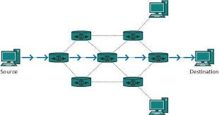
Route
A route may be defined as information that is used to make a decision about how to forward a packet so that it will reach its intended destination network.
Routers look up routes in the routing table to figure out how to forward data.
Direct route and Indirect route.
SLIDE NO: 24

Slide 26
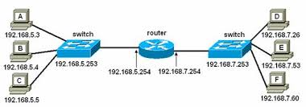
Gateway
A gateway is a network node that connects two networks using different protocols together.
It also acts as a “gate” between two networks. It may be a router, firewall, server, or other device that enables traffic to flow in and out of the network.
It enables traffic to flow in and out of the network.
IPSec
SLIDE NO: 25

Slide 27
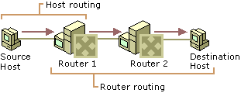
Routing
Routing is the process of transferring data across an internetwork from a source host to a destination host. Routing can be understood in terms of two processes: host routing and router routing
SLIDE NO: 26

Slide 28
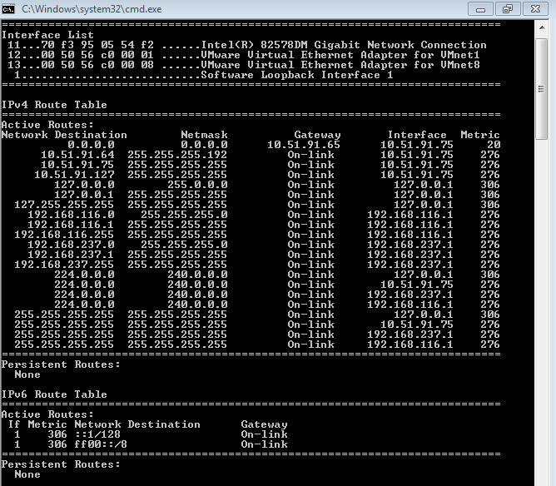
What is host routing table and default routes?
Host routing table:
A routing table on the host yields the forwarding address of the router to be used to reach the desired destination network ID.
The route print or netstat -r command can be used to display the host routing table.
SLIDE NO: 27

Slide 29
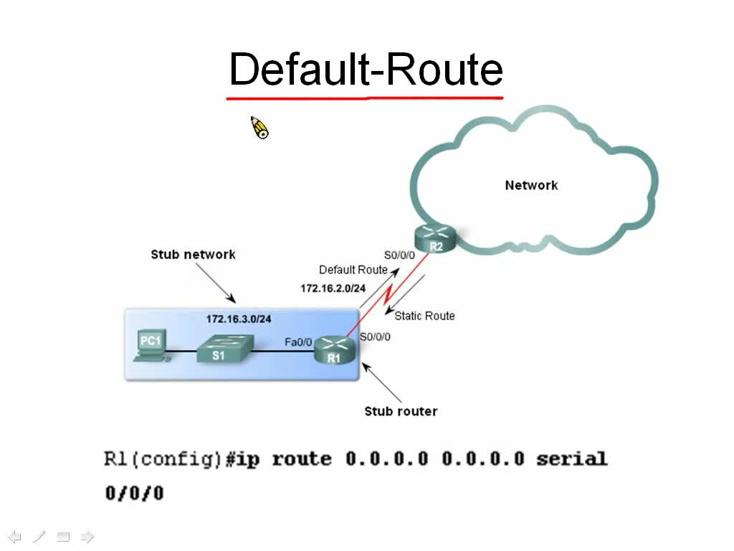
Default Routing
The default route is a setting on a computer that defines the packet forwarding rule to use when no specific route can be determined for a given Internet Protocol (IP) destination address.
SLIDE NO: 28

Slide 30

SLIDE NO: 29

